Slide 1
Crossword Generator
Made by Vakulinskiy Olexandr
Academic Advisor: Grebenovich Yuliya Evgenivna

Slide 2
Goal and problems
Goal: creating crossword genrator program
Problems
Investigate Backtracking algorithm
Create functions for making, saving and reading a grid model
Create function for reading wordlist
Make design of program

Slide 3
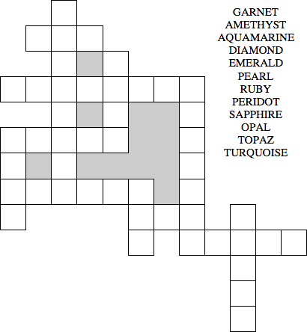
CRISS cross
I've decided to use criss cross puzzle, not classical crossword, becase questions which we use in classical crossword are not important for my program. My goal it's correctly filled grid so, I can use already made wordlist. So criss cross is the best choice for such program

Slide 4
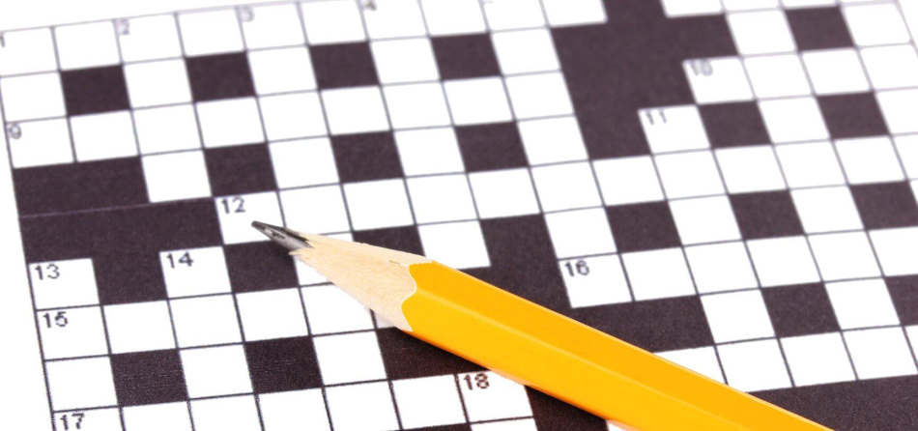
Generating method
Step1
Making a dictionary with sections
(words with the same length)
Step 2
Sorting words
Compare amount of horizontal and vertical words
Step 3
Put words in first direction, put words in another direction considering the interception of first line words
Fill the grid

Slide 5
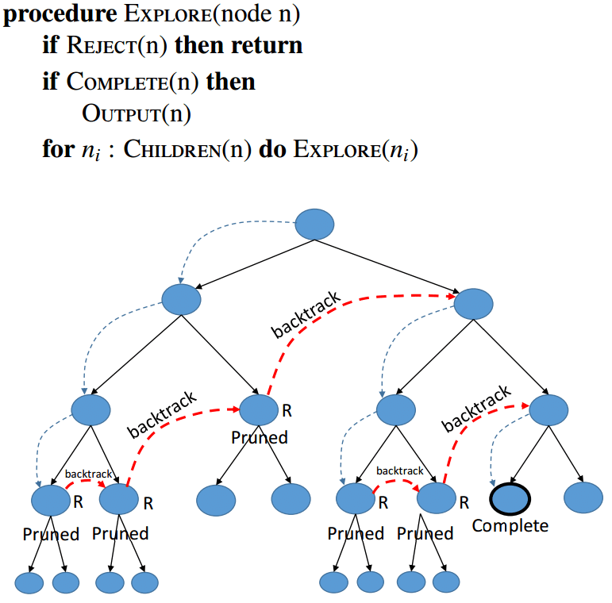
Backtracking
At every step we are looking for appropriate variant for specific word model. If search is successful we go to another model. We'll find result for first line fast, because it depends only on length and value (used or not)
Searching second line results is almost similar, but now it also depends on intersections

Slide 6
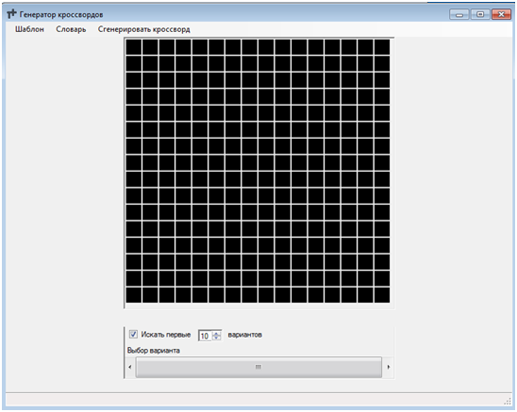
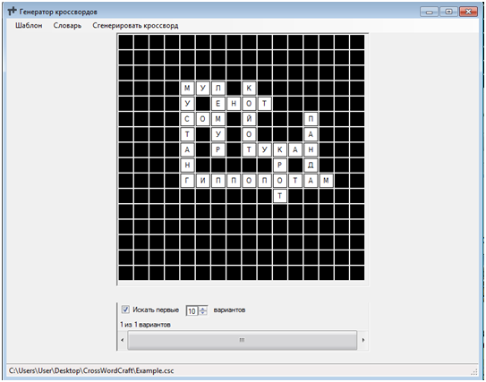
Results
So we have a program, which can solve any criss cross puzzle. User is able to create different grid models and save it. Also if you have more difficult puzzle, program can find couple of variants and show it to you

